Slide 1
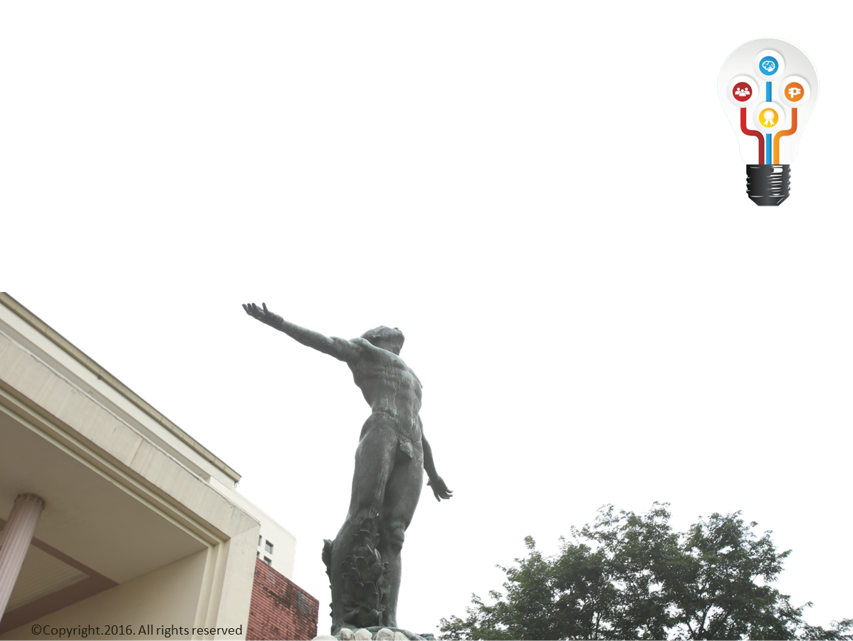
IP Policy on
Theses/Dissertations

Slide 2

Memo FRN 16-038
I
External: With permission from author/adviser
External: With Non-Disclosure Agreement
P
C
External: With permission from author/adviser
External: With permission from author/adviser
External: With Non-Disclosure Agreement
External: With Non-Disclosure Agreement
Internal: Conforme
Internal: Conforme
Internal: Conforme
F
Full public access
Full public access
Full public access
Full public access
Full public access
Year 1
Year 2 onwards

Slide 3
Notes:
  For “C” cases (with confidential information), the third-party will be asked to redact parts of the thesis/dissertation pertaining to their confidential information.

Slide 5

Conforme

Slide 6

University Permission Page

Slide 7
FAQs
Q: What do I do after the 1 year restriction has passed?
A: Paste over the relevant portion.

Slide 8

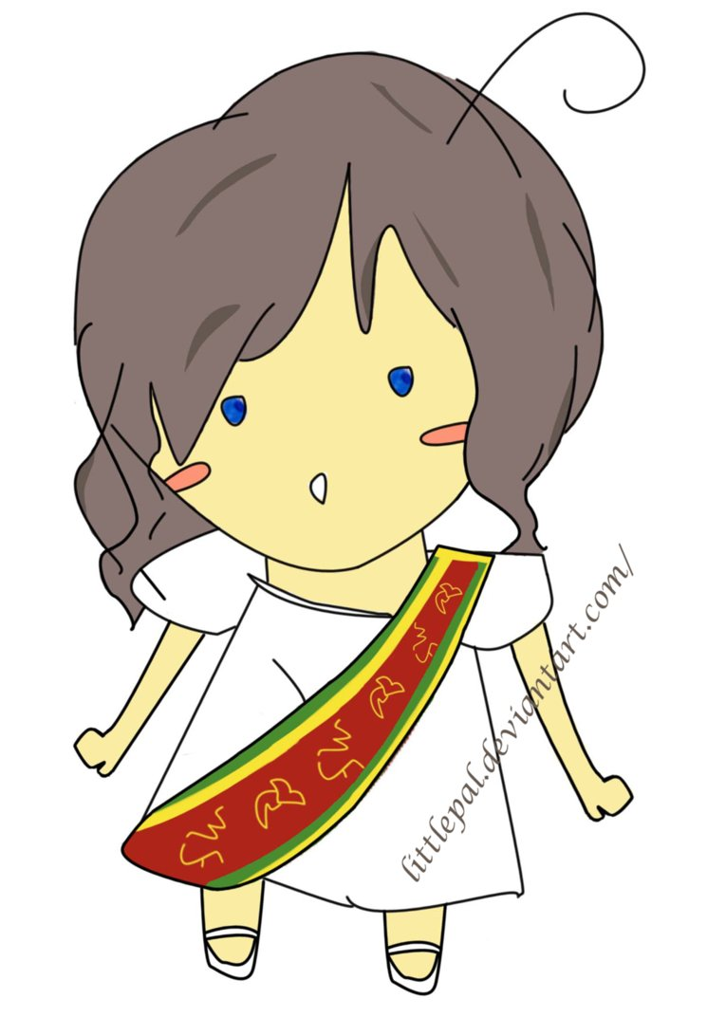
FAQs
Q: What if student and adviser disagree on need for access restriction?
A: Ideally both agree. If not, student/author decides.

Slide 9

FAQs
Q: Can restriction be renewed?
A: Yes, provided that a request is made every year (continuous, no gaps).
2021
2020
2019
2018
2017
2016

Slide 10
FAQs
Q: How does a UP student, staff, researcher get access to restricted theses?
A:
Signed conforme
Get access

Slide 11
FAQs
Q: How does an outsider get access to restricted theses/dissertations?
A:
Request Letter to Unit Head
Non-Disclosure Undertaking
Written permission from author/adviser
Submit all documents to Unit
Get access

Slide 12
FAQs
Q: What about theses/dissertations before this Memorandum?
A:
PAEP Memo 2012-03
BMP Memo 2012-011
FRN Memo 2015-038
March 15, 2012
October 20, 2015

